Slide 1
How do code documentation efforts spread over class hierarchy?
Mattia Pedrazzi
Seminar Software Engineering, FS2022
Supervised by Pooja Rani
Software Engineering Group (SEG)

Slide 2
Motivation
To extend / use the code base, developers need
Enough Documentation
Good Documentation Quality
Well Spread Documentation
- Interfaces
- Uses
- Superclasses
Notes:
Give an example of Juice project, show a screenshot of the project that it has 10000 of classes (that it is not possible to explore the project without navigating to the individual source code of the classes, maybe a folder structure).
, In such projects, how do we know what are the important classes, which classes needs to be documented?

Slide 3
Motivation
To provide good documentation, the project maintainers need to know
Which are the important classes?
Which classes need documentation?
High fan-in/out, inherited often
Notes:
Important class: A class that have lots of methods, it uses lots of other clases, and used by other classes, has lot of subclasses.
TODO: check the official definition of fan-in, fan-out.

Slide 4
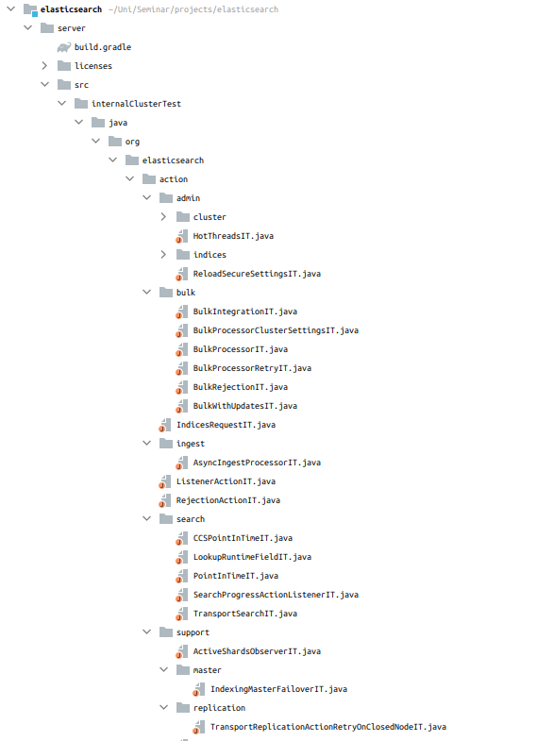
Motivation
Example
Elasticsearch
19’931 Classes
1’171 Interfaces
14’288 Inheriting Entities
1’218 Inherited Entities
Notes:
Give an example of Juice project, show a screenshot of the project that it has 10000 of classes (that it is not possible to explore the project without navigating to the individual source code of the classes, maybe a folder structure).
, In such projects, how do we know what are the important classes, which classes needs to be documented?
Note: Guice is a relatively small project, I’d rather show elasticsearch, since it’s the biggest project.

Slide 5
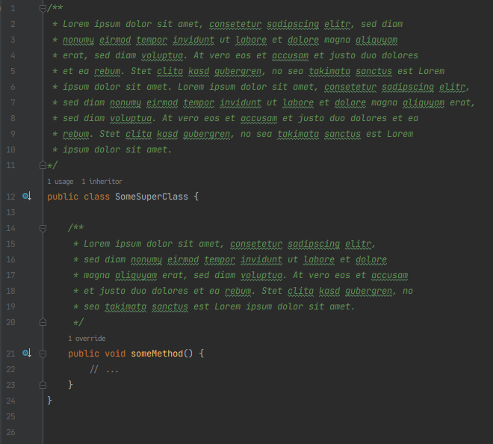
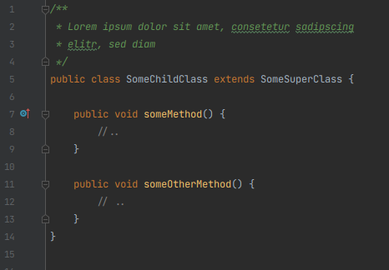
The Problem
Notes:
waiting for data to find example
Note: actually very difficult to find examples where it would fit in one slides, so imma keep this

Slide 6
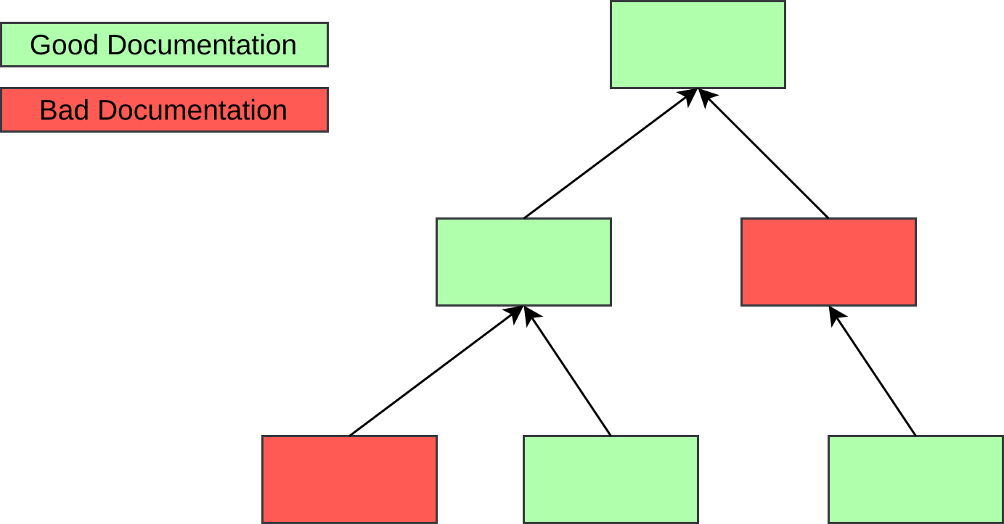
The Problem
Where is the documentation lacking?
Notes:
Use the same color as used in the visualiztion

Slide 7
The Goal
Extract hierarchy and documentation data
Provide useful visualization
Identify weak and strong documentation points (Quantity)

Slide 8
Related Work
Inheritance depth plays a role in the understand of oo software
six to four levels of inheritance is where problems start
Daly J., Brooks A., Miller J., Roper M., Wood M., “Evaluating Inheritance Depth on the Maintainability
of Object-Oriented Software”,Empirical Software Engineering, 1, pp. 109-132, Kluwer Academic Publishers, Boston, 1996

Slide 9
Related Work
Role and Features of Documentation
Documentation reuse improves productivity
Documentation inheritance
Information hiding
Sametinger J. “Reuse Documentation and Documentation Reuse”, Dept. of Computer Science, Texas A&M University, Texas, U.S.A, 1996

Slide 10
Related Work
Metrics
Schreck, D., Dallmeier, V., Zimmermann, T. “How Documentation Evolves Over Time”, Dept. of Computer Science, Saarland University, Saarbrücken, Germany, 2007

Slide 11
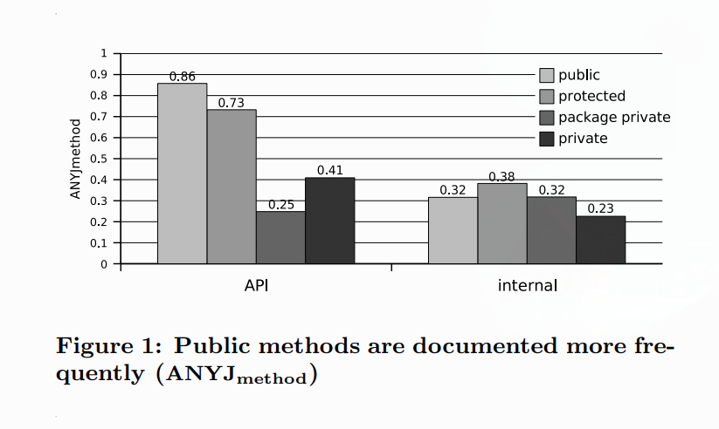
Related Work
Eclipse Evaluation
Schreck, D., Dallmeier, V., Zimmermann, T. “How Documentation Evolves Over Time”, Dept. of Computer Science, Saarland University, Saarbrücken, Germany, 2007
Notes:
Add some important papers what people are doing in this direction
Use connected papers https://www.connectedpapers.com/main/34a99e1e0460beb18fe5c8e7492b9990b0cee68c/Measuring-energy-footprint-of-software-features/graph
to find similar and important papers

Slide 12
Our Approach
Java Doc Extractor (golang)
- Visualize uses and relations with Roassal (Pharo)
Doc Extractor
JSON Data
Visualization
Java Doc Extractor Repository: https://github.com/UsernameN0tAvailable/java_doc_extractor
Notes:
TODO: Make a diagram of your approach, put the links in the footer

Slide 13
Our Approach
Projects Analysed
Guava (google)
Guice (google)
Hadoop (Apache)
Framework (vaadin)
CDT (Eclipse)
ElasticSearch
P2 Exercise
Notes:
TODO: Make a diagram of your approach, put the links in the footer

Slide 14
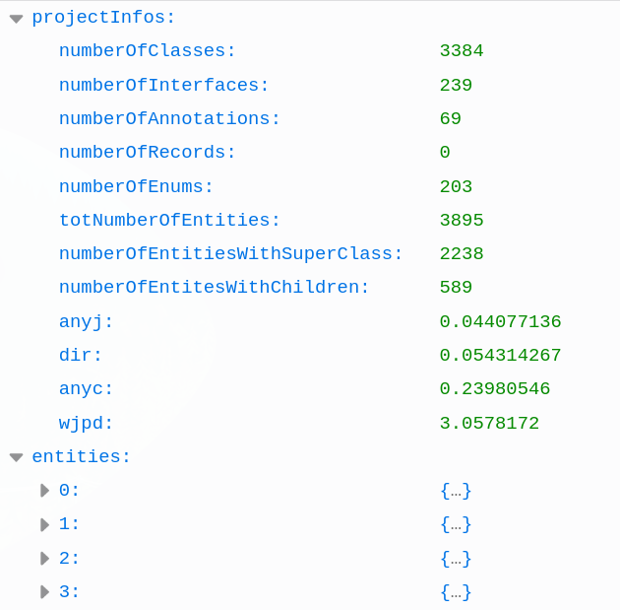
Results
Extractor Output
Notes:
Add the JOSN file, and visluaztion here

Slide 15
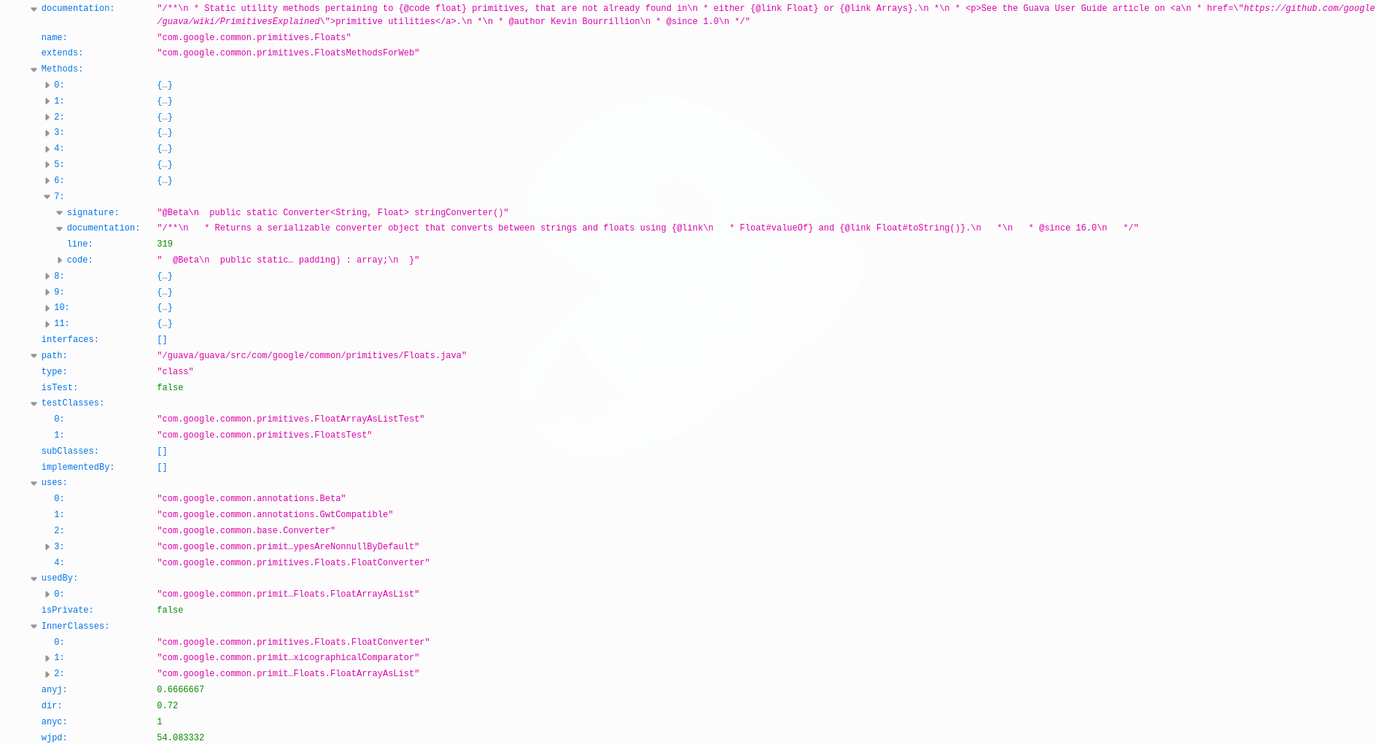
Results
Extractor Output
Notes:
Add the JOSN file, and visluaztion here

Slide 16
Results
Visualization Demo

Slide 17
Results
 | Guice | Guava | Hadoop | Elasticsearch | Framework | CDT
ANYJ | 0.021 | 0.044 | 0.157 | 0.043 | 0.293 | 0.126
DIR | 0.026 | 0.054 | 0.171 | 0.045 | 0.340 | 0.137
ANYC | 0.232 | 0.239 | 0.336 | 0.162 | 0.394 | 0.320
WJPD | 1.031 | 3.058 | 1.587 | 1.596 | 10.229 | 3.574

Slide 18
Conclusion
Is the visualization useful?
User evaluation needed
Additional metrics needed

